Slide 1

IMS-Starter
Vicente Conte Couto
https://github.com/ecoutoo/IMS-Starter

Slide 2
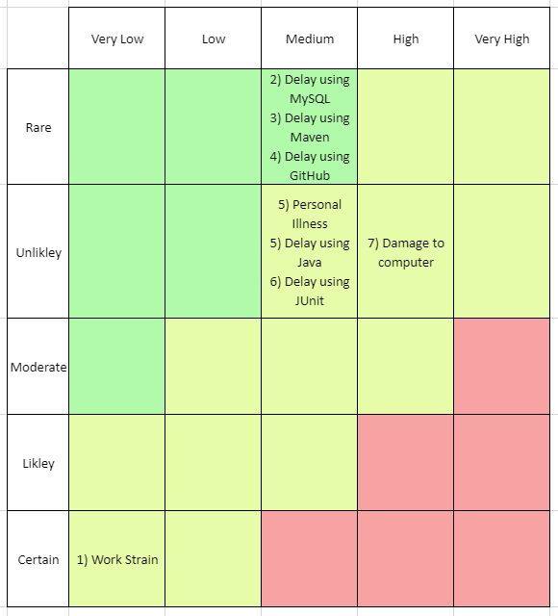
Risk Assessment
Previous work
Mitigating risks

Slide 3
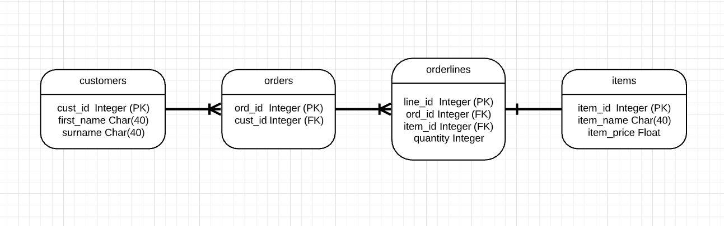
Database
ERD evolution
Database normalisation to remove Order and Item many to many relationship
Potential other tables to be added?

Slide 4
Database
INSERT INTO `customers`(`first_name`, `surname`) VALUES ('jordan', 'harrison');
INSERT INTO `items`(`item_name`, `item_price`) VALUES('cola', 1.50);
INSERT INTO `orders`(`cust_id`) VALUES(1);
INSERT INTO `orderlines`(`ord_id`, `item_id`, `quantity`) VALUES(1, 1, 2);

Slide 5
Functionality
Each of the requirements met!
Customer CRUD
Item CRUD
Order CRUD
Order ADD/DELETE item
Order calculate cost

Slide 6
Functionality
Order read and calculate cost

Slide 7
Jira Boards (1 Sprint, 38 tasks)
3 Epics (Customer (4SP), Item (32SP), Order (37SP))
4 User stories each for CRUD , a separate story for GitHub link (2SP)
User stories separated into smaller tasks

Slide 8
Testing (80.1% coverage, 46 tests)
Mockito and Junit
100% coverage :
Customer, Item, Order classes
Customer, Item, Order controller classes
Customer, Item DAO classes
Partial coverage:
Order DAO class (Only exceptions not covered)
Enums (Domain, Action)
Util and DBUtil classes (91% coverage DBUtil)
Runner and IMS (25% IMS coverage)

Slide 9
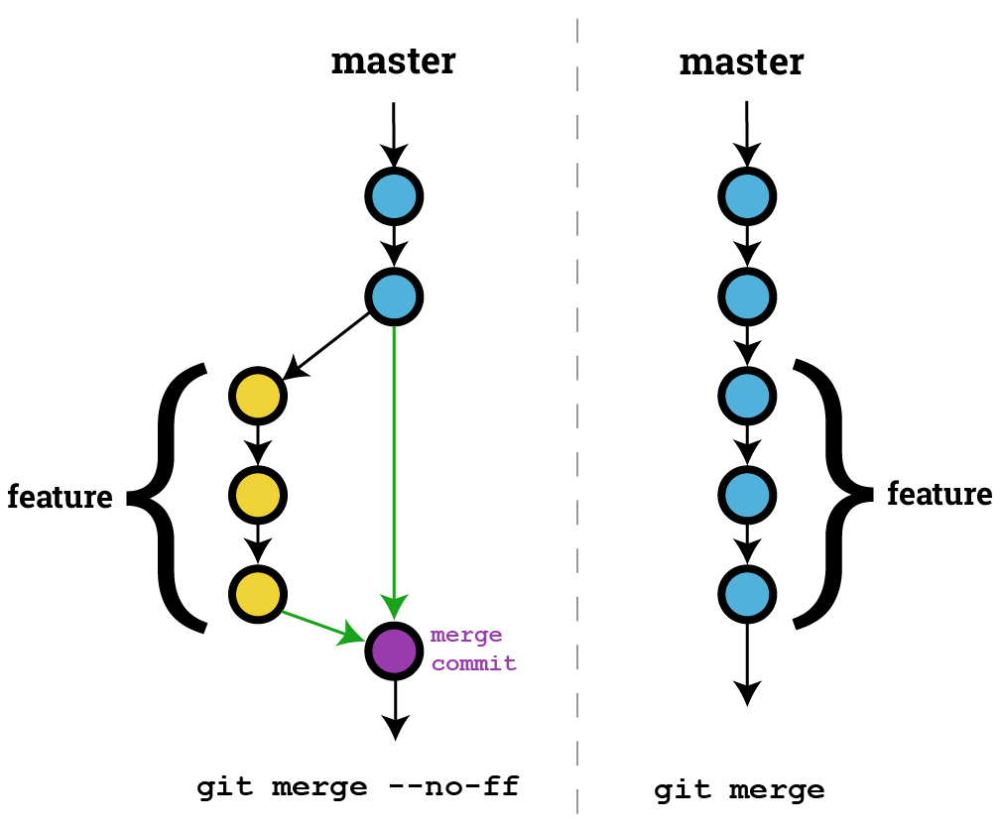
GitHub
Branch structure (Fast forward merge)
Merge
Merge
Merge
Merge
Merge
f001
dev
f002
dev
f003
dev
t001
dev
Main
Jira Integration
Database created
SQLs created
Customer code finalized
Item code finalized
Order code finalized
Testing code finalized

Slide 10
Lessons Learnt
Improved Jira boards
More frequent commits, better change documentation
Use test driven development approach
Potentially use more complicated database

